Slide 1
Boosting Algorithm
(Regressor)

Slide 2
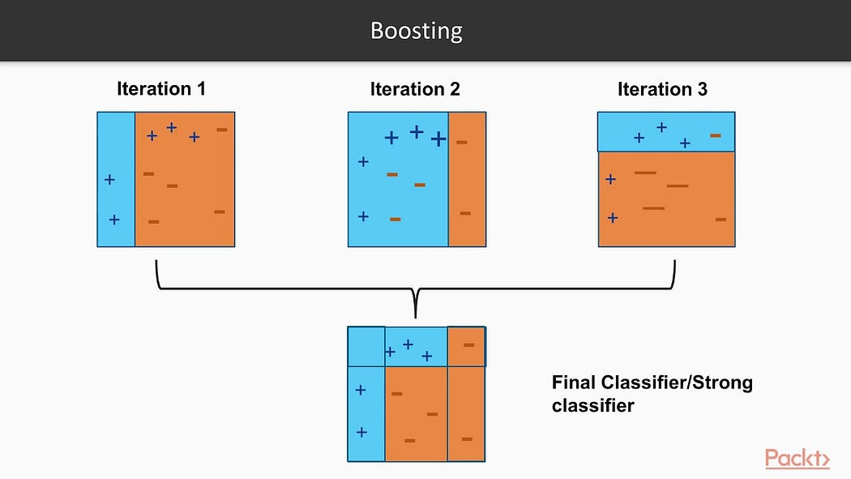
AdaBoost Regressor
Sequential process, new models are build based on errors of previous model to improve prediction.
For the error datapoints the weight addition will happen.

Slide 3
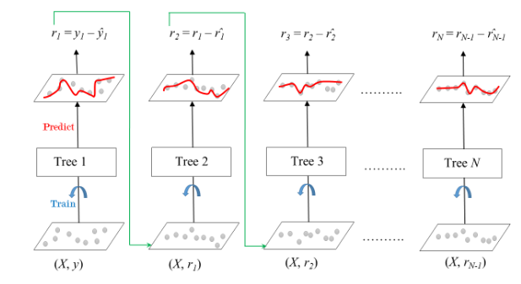
Gradient Boosting Regressor
In this boosting technique, loss functions are given as input to the succeeding models.
Each new model is trained to minimize the loss function.

Slide 4
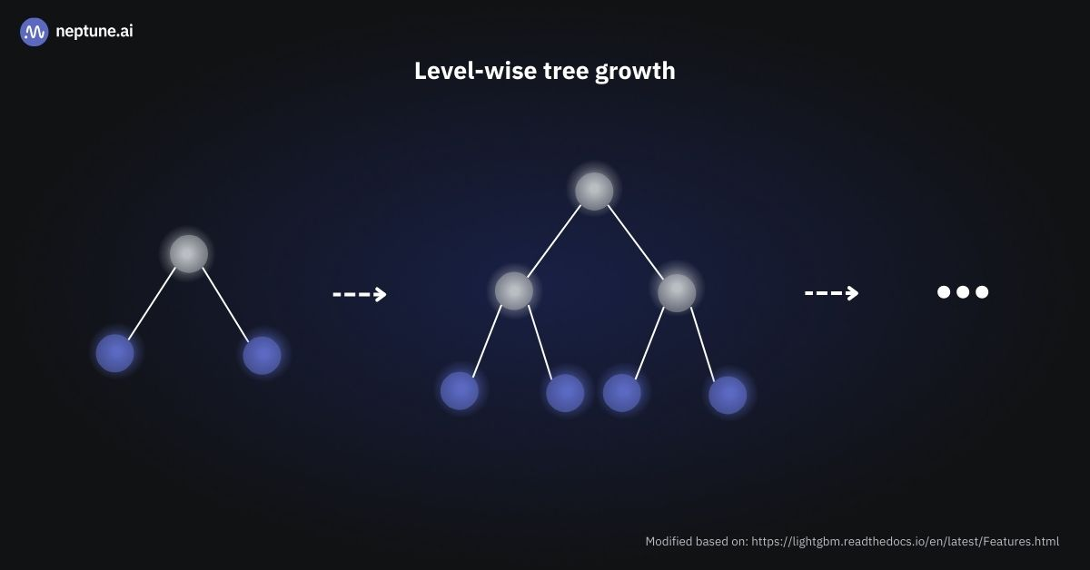
XGBoost Regressor
Similar to Gradient boosting but XGBoost is faster and have multiple features than GB.
Regularization and Parallelization are the key features.
It supports Level-wise tree growth.

Slide 5
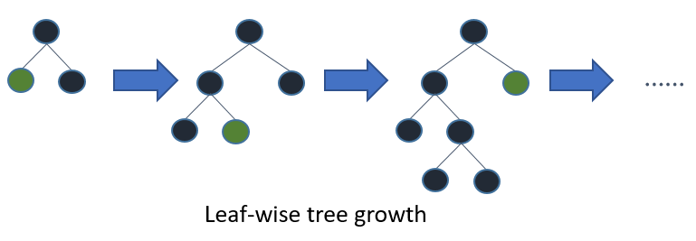
LGBoost Regressor
LightGradientMachineBoost supports leaf-wise growth.
It has In-built support for handling categorical features.
Its good algorithm for large and complex datasets.

